Slide 1

Travel Data Analysis – Airbnb Data Analysis
By: Lokesh Attarde

Slide 2
Introduction
Airbnb is an American company that facilitates an online marketplace for lodging, primarily homestays for vacation rentals, and tourism activities. It basically connecting travelers with local hosts who want to rent out their homes with people who are looking for accommodations in that locality. On the other hand, this platform enables host to list their available space and earn extra income in the form of rent and it also enables travelers to book unique homestays from local hosts, saving them money and giving them a chance to interact with locals.

Slide 3
Objective
Objective:
In the world of rising new technology and innovation, Travel industry is advancing with the role of Data Science and Analytics. Data analysis can help them to understand their business in a quiet different manner and helps to improve the quality of the service by identifying the weak areas of the business.
Benefits:
Help out to make better business decisions.
Help analyze customer trends and satisfaction, which can lead to new and better products and services.
Gives better insight of customers base.
Helps in easy flow for managing resources.

Slide 4
Problem Statement
Travel industries are having important reflection of the economy from past few decades, and Airbnb housing price ranges are of great interest for both Hosts and Traveler. In this project, we are analyzing the various aspects with different use cases which covers many aspects of airbnb listings. It helps in not only understanding the meaningful relationships between attributes but it also allows us to do our own research and come-up with our findings.

Slide 5
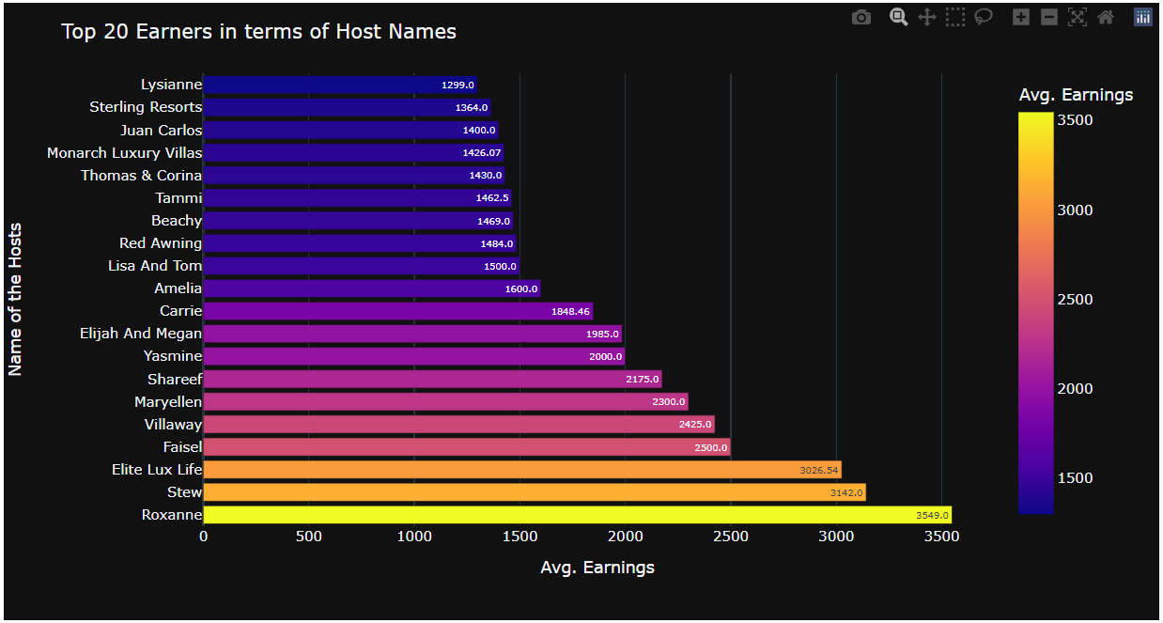
1. Top Earners (Hosts):
Conclusion:
In the above Chart, we've listed/ploted Top 20 Earners in terms of Hosts, one after the other.
From the above visual, We can say that "Roxanne" is the Top Earner followed by "Stew" and "Elite Lux Life".

Slide 6
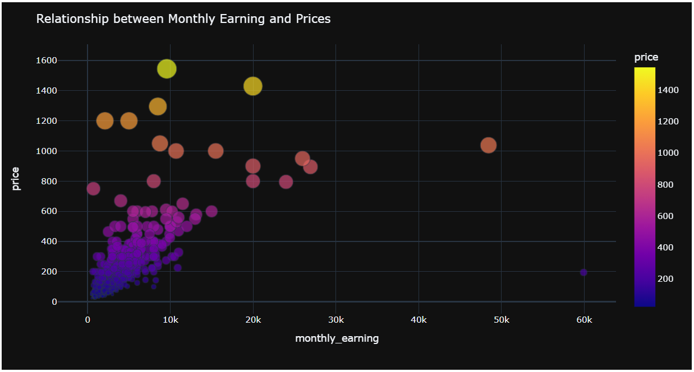
2. Relationship between Monthly Earning and Prices:
Conclusion:
From this, you can come up with Various Conclusions like -
Bigger the Bubble, higher the Price is... Similarly, Smaller the Bubble, lesser the Price is...
As the "Price" increases, we can see that "Monthly Earning" decreases. This might be happened because Most of the Guests prefer Affordable/Budget-Friendly Rooms and We can also confirm the same from above plot Dense Area (High density).
Moreover, We can also say that, Some Rooms made great Fortune which are having Meager Price (I.e. '195'), has Monthly Earning of "60K".
On the other hand, the Expensive Rooms which are having More Price, We can say that, those doesn't make Much Earnings. Same we can see, For Price "1545", "1430", "1295", and "1200", the Monthly Earnings were "9579", "20K", "8500", and "5000" respectively. This was again happened because Most of the Guests prefer Affordable/Budget-Friendly Rooms.
So, that's a Conclusion we can drawn from this Scatter Plot.

Slide 7
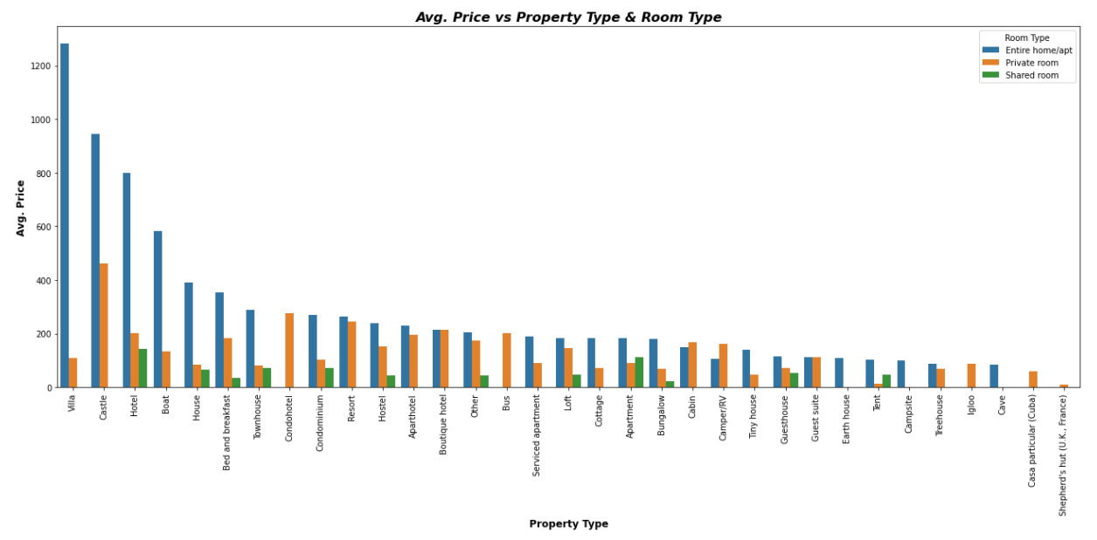
3. Price comparison in terms of "Property Type" and "Room Type":
Conclusion:
From this "Bar Plot", We can say, the "Villa", "Castle", "Hotel", "Boat", "House", etc. These are the Most Expensive "Property Types" in terms of "Entire Home/Apt.".
Next, In terms of "Private Room", "Castle", "Condohotel", "Resort", "Boutique Hotel", "Hotel", etc. are the Most Expensive "Property Types".
Similarly, In terms of "Shared Room", We can see that "Hotel", "Apartment", "Condominium", "Town House", "House", etc. are the Most Expensive "Property Types".

Slide 8
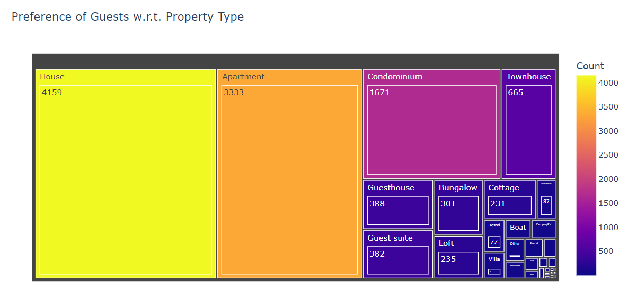
4. Preference of Guests w.r.t. Property Type:
Conclusion:
This beautiful "TreeMap" displays the Most preferred 'Property Type' by Guests.
To conclude this Chart, We can say, "House", "Apartment", "Condominium“ these are the 'Top 3' Most Preferred Property Types by the Guests.
From All these Guests Room Preference, We can observe the one thing that Mostly Guests prefer "Moderate Level Priced" Rooms not Much Expensive, nor Much Less.

Slide 9
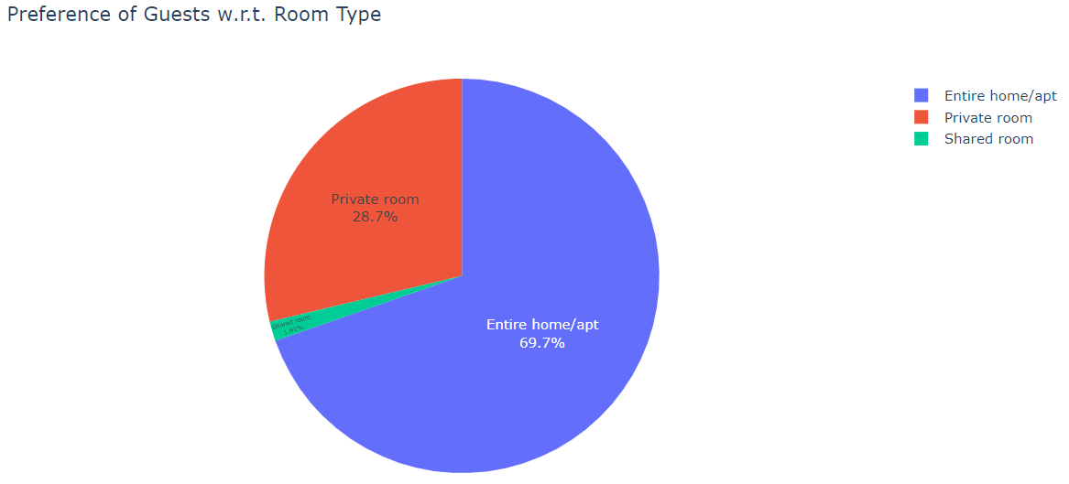
5. Preference of Guests w.r.t. Room Type:
Conclusion:
This beautiful "Pie Chart" displays the Most Preferred 'Room Type' by Guests.
To conclude this Chart, We can say, "Entire home/apt" was the First Choice/Most Preferred Room Type by approx. '69.7%' Guests followed by "Private Room" and "Shared Room" which are about '28.7%' & '1.61%' respectively.
From Overall distribution, We can say, "Shared Room" has much Less Preferred by the Guests. This might because of there is a possibility like Most of the Guests Not prefer to Stay in Shared Room because they don't want to lose the Privacy there / as there is lack of Privacy and got disturbances by others.

Slide 10
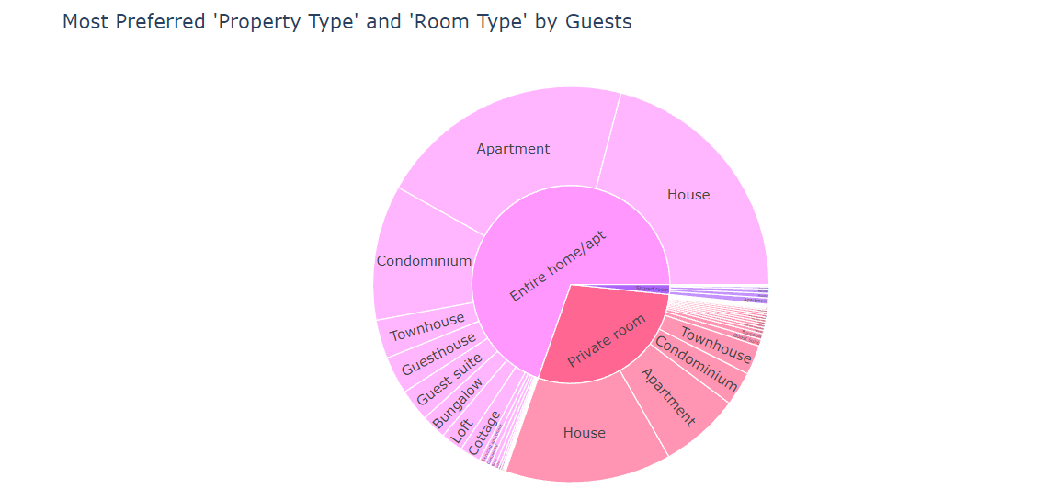
6. Most Preferred "Property Type" and "Room Type" by Guests:
Conclusion:
To conclude this Chart, We can say, "Entire home/apt" was the First Choice/Most Preferred Room Type followed by "Private Room" and "Shared Room".
From Overall distribution, We can say, "Shared Room" has much Less Preferred by the Guests.
Now, In terms of "Entire home/apt" Room Type, We can see, "House", "Apartment", "Condominium" these are the 'Top 3' Most Preferred Room Types by the Guests.
Then, In case of "Private Room", again we can see, "House", "Apartment", "Condominium" these are the 'Top 3' Most Preferred Room Types by the Guests.
However, In case of "Shared Room", We can see that, "Apartment", "House", "Hotel", "Condominium" these are the Top Most Preferred Room Types by the Guests.

Slide 11
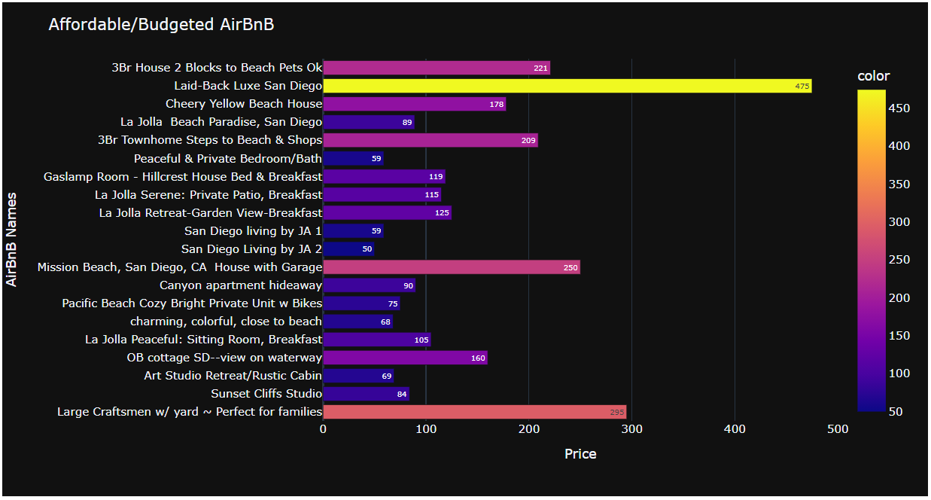
7. AirBnB's that are below 500 (Budget Hotels) as well as Affordable:
Conclusion:
Now, We can Conclude that, We have Total "11091" AirBnB's which are the Affordable/Budgeted AirBnB's that are below "500". It means, these are come under our "Budget Hotel" as well as they are "Affordable".
From this above Visual, We can see the some of the Affordable/Budgeted AirBnB’s along with their Names and Price.

Slide 12
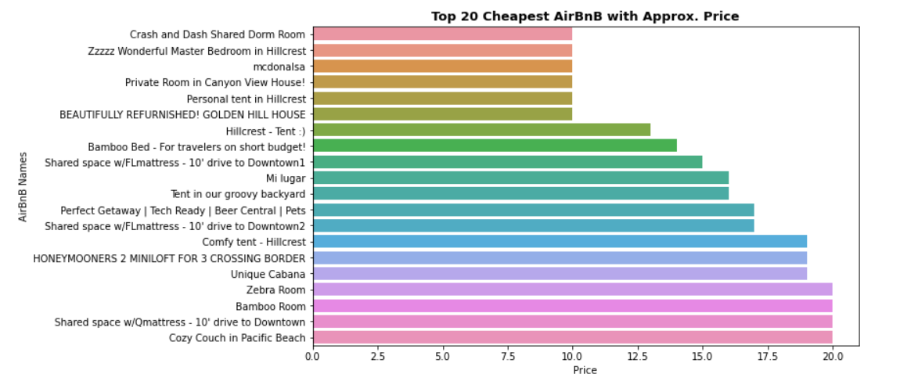
8. Top 20 Cheapest AirBnB with Approx. Price:
Conclusion:
From this above Visual, We can see the our Top 20 Cheapest AirBnB with Approx. Price.

Slide 13
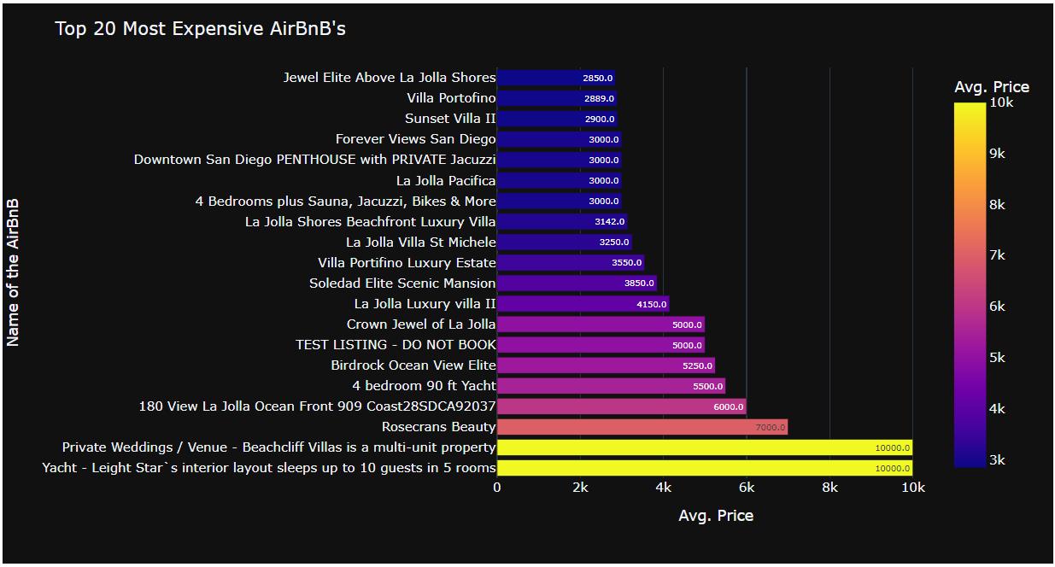
9. Most Expensive AirBnB's:
Conclusion:
From this visual, We can say that "Private Weddings / Venue - Beachcliff Villas", "Yacht - Leight Star's interior layout" are the Most Expensive ones followed by "Rosecrans Beauty" and "180 View La Jolla Ocean Front".
On Top of that, We've also observed that Most of these/Almost All these Expensive ones has bookings for "Entire home/apt" as a Room Type. Hence, It seems to be like Most of the guests prefer to Stay in "Entire home/apt" and AirBnB has More Earners from these kind of Room Types.

Slide 14
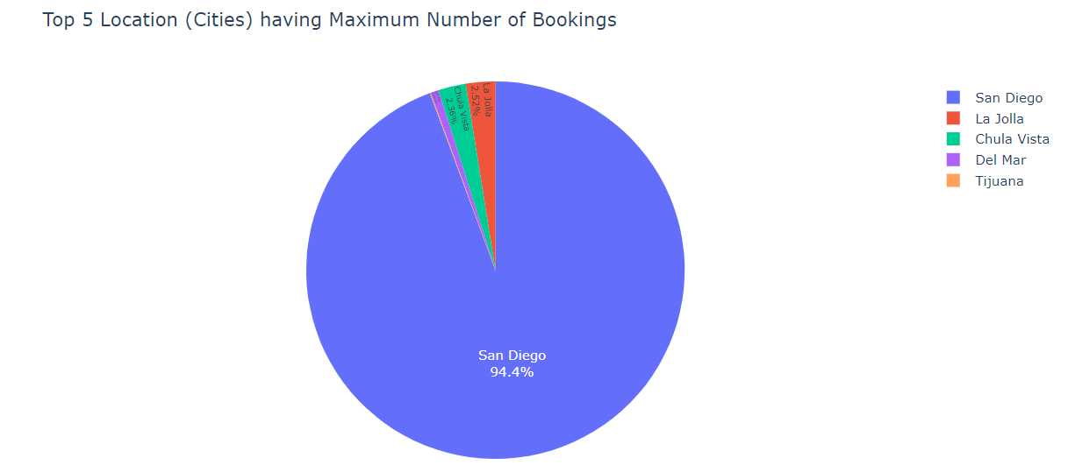
10. Any particular Location (Cities) getting Maximum Number of Bookings:
Conclusion:
This Pie Chart, shows Top 5 Cities who's having Maximum Number of Bookings.
To conclude above Chart, We can say, Most of the Bookings of around "94.4%" were takes place for "San Diego" City as lot of Tourist Attractions/Places (Neighbourhood) are there to Explore in the Vicinity of "San Diego" followed by "La Jolla", "Chula Vista" and so on...

Slide 15
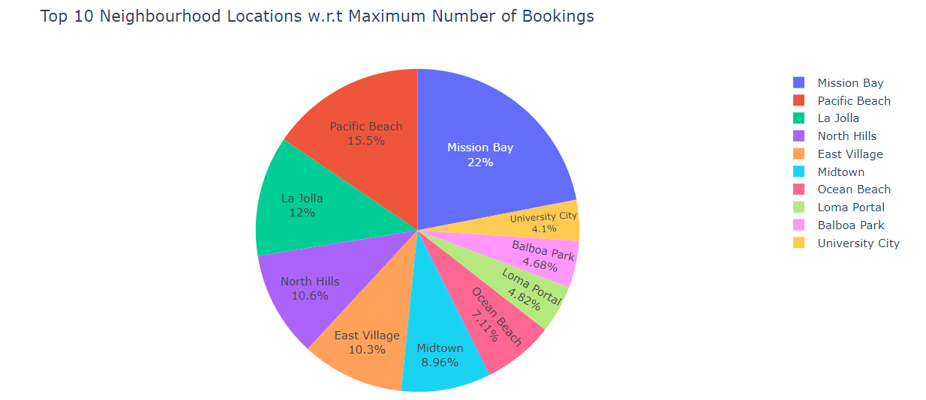
11. Any particular Location (neighbourhood) getting Maximum Number of Bookings:
Conclusion:
This Pie Chart shows, Top 10 Neighbourhood Locations who's having Maximum Number of Bookings.
To conclude above Chart, We can say, In terms of Neighborhood Locations, Most of the Bookings were takes place for "Mission Bay" of around "22%" followed by "Pacific Beach", "La Jolla" which has "15.5%" & "12%" respectively...

Slide 16
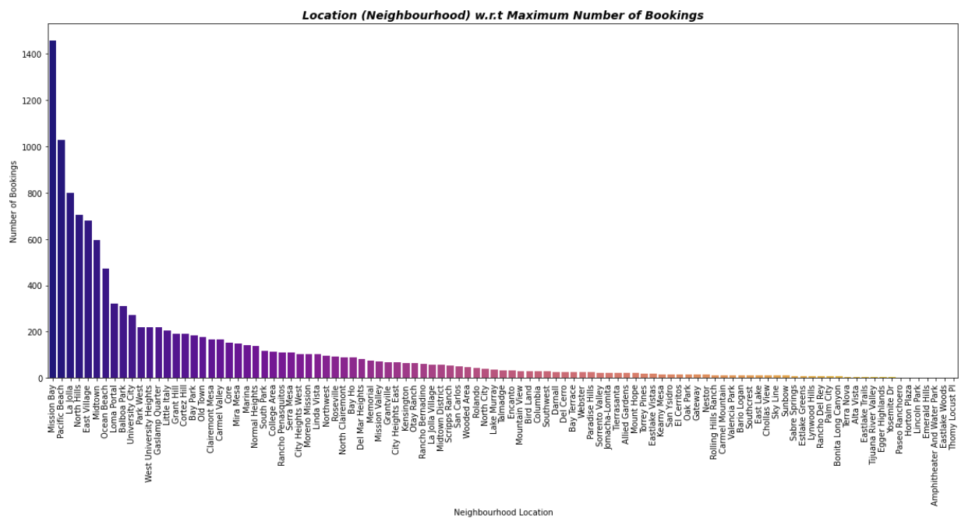
11. Any particular Location (neighbourhood) getting Maximum Number of Bookings:
Conclusion:
This Bar Chart shows, Neighbourhood Locations who's having Maximum Number of Bookings.
To conclude above Chart, We can say, In terms of Neighbourhood Locations, Most of the Bookings were takes place for "Mission Bay" of around "22%" followed by "Pacific Beach", "La Jolla" which has "15.5%" & "12%" respectively and so on...

Slide 17
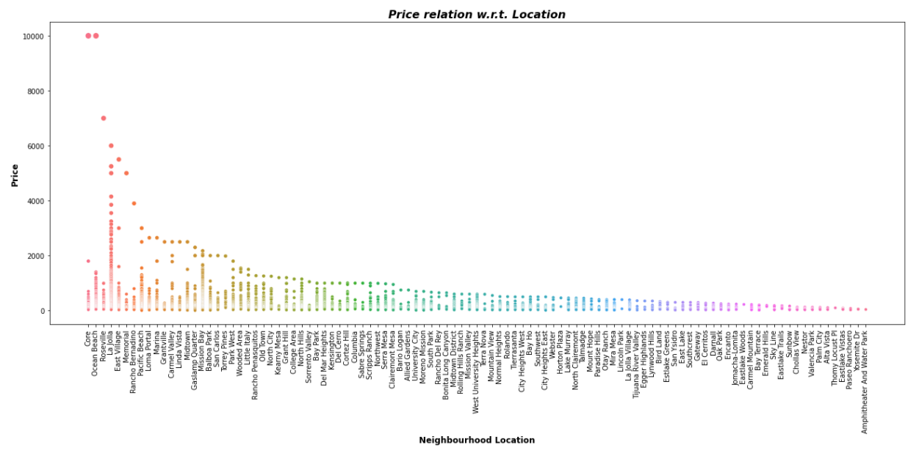
12. Price relation with respect to Location - (Price vs. Location)
Conclusion:
From this Scatter Plot, It is clear that, some of the AirBnB's that are located at "Core" and "Ocean Beach", were Super Expensive and at the same time, there are less Number of AirBnB's available if compare with "Mission Bay", "Pacific Beach", "La Jolla", "North Hills", "East Village" and "Midtown".
On the other hand, We can say, best Location (Neighborhood) with lower Priced AirBnB has Most of the Bookings by the Guests.
If we deep dive into this, We can clearly see that, As "Mission Bay" Location has Moderate Level Priced, Most of the guests preferred to Stay there. Next, If we see the "Pacific Beach" Location, Prices are slightly high compared to "Mission Bay". Hence, less number of guests prefer to stay here than "Mission Bay".
Similarly, "La Jolla" Location, seems to be Expensive compared to "Mission Bay" & "Pacific Beach". Therefore, the Number to bookings were lesser than these 2 Locations.

Slide 18
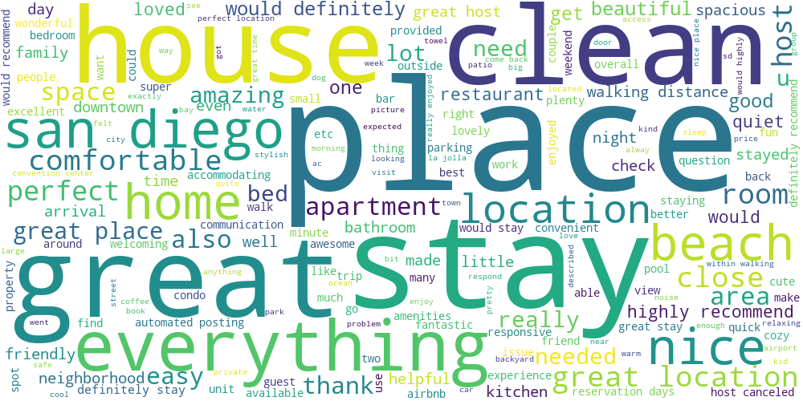
13. Analysing "Reviews/Comments" of the Customers:
Conclusion:
From this "Word cloud", We can definitely come-up with some Conclusion like - These are exactly the "Reviews/Comments" of the Customers.
It means, Our "Customers" are going to prefer All these "Keywords" such as - "great", "place", "clean", "stay", "house", "great location", "comfortable", "highly recommend", And many more.
Most of the time, "Customers" are going to prefer, these "Keywords", So we can easily examine What exactly the "Behavior and Views of our Customers.

Slide 19
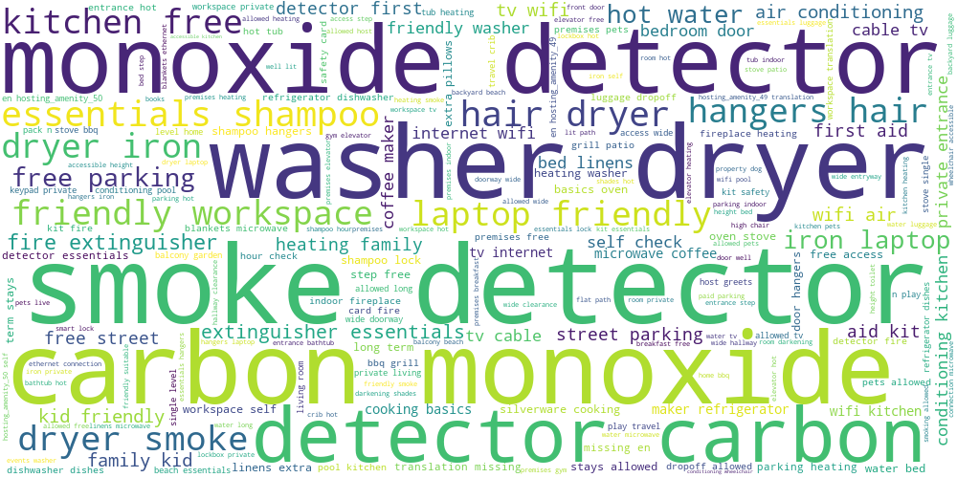
14. Analyzing Most Common "Amenities" provided by the AirBnB's to their Customers:
Conclusion:
These are Most Common "Amenities" provided by the AirBnB's to their Customers.
It means, Most of the AirBnB's has some Common "Amenities" / Most common "Amenities" provided by the AirBnB's to their Customers such as - "Smoke Detector", "Monoxide Detector", "Carbon Monoxide", "Washer Dryer", "Carbon Detector", "Essentials Shampoo", "Hair Dryer", "Fire Extinguisher", etc. These are the Mainly/Primarily provided Amenities by AirBnB's by taking into consideration 'Safety Precautions' and general 'Essentials things'.
Some of the AirBnB's are also comes with other Amenities like - "Free Parking", "TV", "wifi", "hot water", "First Aid", etc.

Slide 20
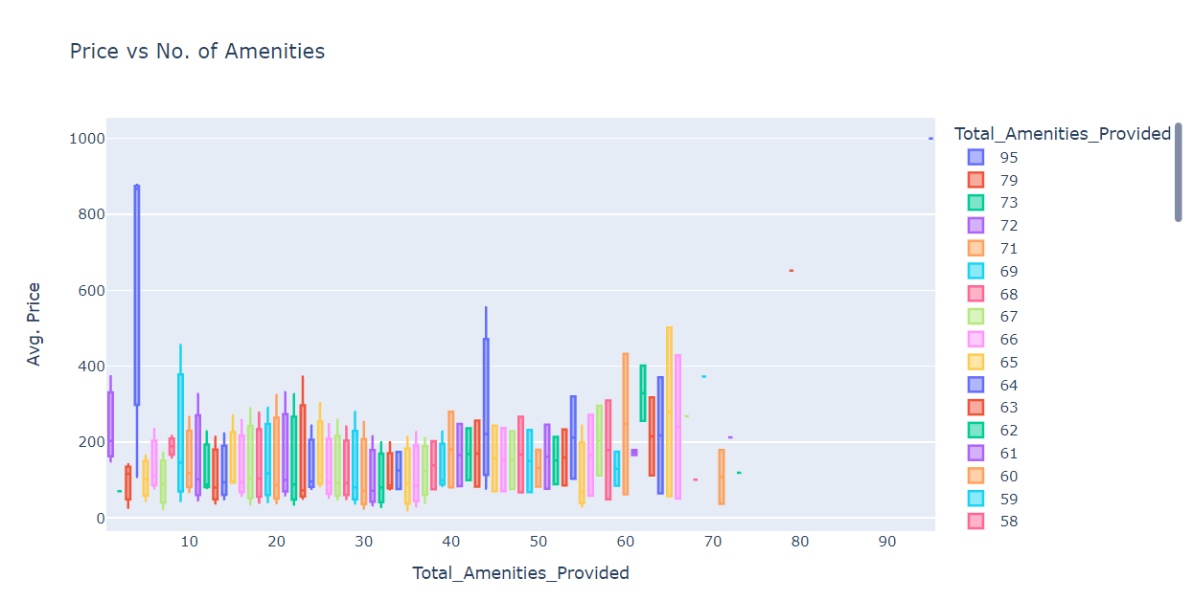
15. Price vs Amenitites:
Conclusion:
From this "Box Plot", We can see that, there are few Super Luxurious/Expensive AirBnB's which provides lot of Amenities I.e. Total of "95" which will cost around "1000" Dollars. Then, the other one, will be providing Total of "79" Amenities which will costs "652" Dollars.
On the other hand, there are some Expensive AirBnB's, who's Median Cost ranges from "867" Dollars and goes upto "877.87" Dollars at Max. However/Although, being such a Super Expensive AirBnB, if we see the Total Number of Amenities they are Providing along with, then we can see, they are providing just '4 Amenities' at this Huge Price.
Furthermore, there are so many Affordable/Budgeted AirBnB's available and they are providing lot of Amenities too that will definitely fulfill the Basic as well as Essential Requirements of these Customers.

Slide 21
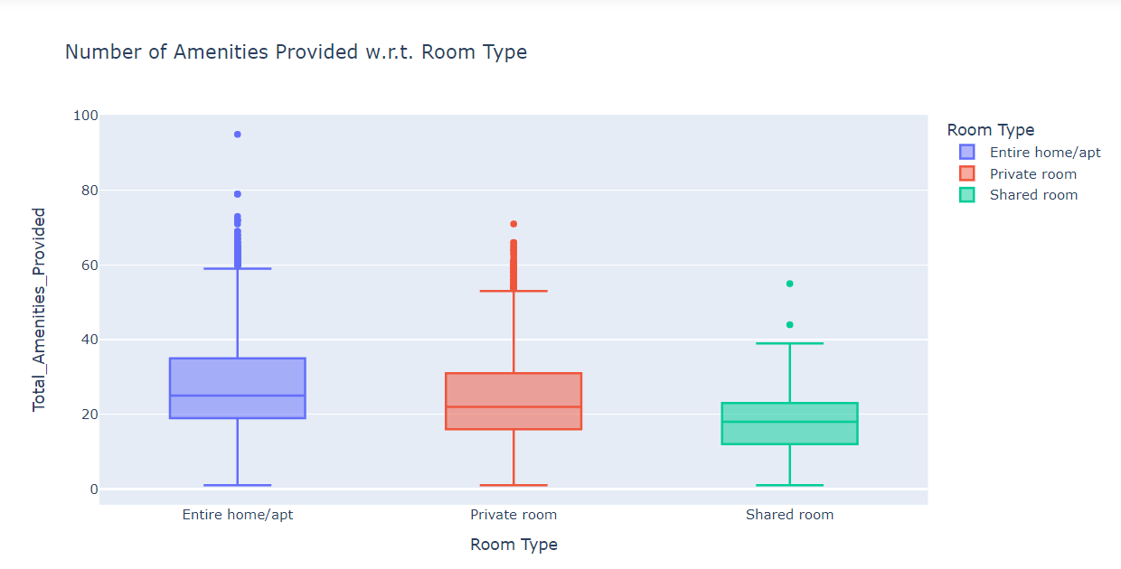
16. Total Number of Amenities Provided w.r.t. Room Type:
Conclusion:
"Entire Home/Apt." is prominent in terms of providing the Number of Amenities followed by "Private Room" and "Shared Room".
From this "Box Plot", We can also conclude that "Entire Home/Apt." are providing Total of "95" Amenities at Max and "50%" of this Category AirBnB's were giving approx. '25' Amenities which comprises/includes 'Basic' as well as 'Essential Amenities' with 'Safety Precaution's Amenities'.
Next, In terms of "Private Room", they are providing Total of "71" Amenities at Max and "50%" of this Category Rooms were giving around '22' Amenities which comprises/includes some 'Basic' as well as 'Essential Amenities' with some 'Safety Precaution's Amenities'.
On the other hand, "Shared Rooms" are providing Total of "55" Amenities at Max and "50%" of these Category Rooms were giving almost '18' Amenities which comprises/includes few 'Basic' as well as 'Essential Amenities' with few 'Safety Precaution's Amenities'.

Slide 22
Thank You,
Lokesh Attarde

